Slide 1
Updates
2026-09-10

Slide 2
Design Issues
RHD2164: B.O.
Had to redesign some of the boards
Main change: 1x RHD2164 -> 2x RHD2132
All the redesigns are done
PCB review: In progress
BOM: Waiting on 1 quote only (RHD2132)

Slide 3
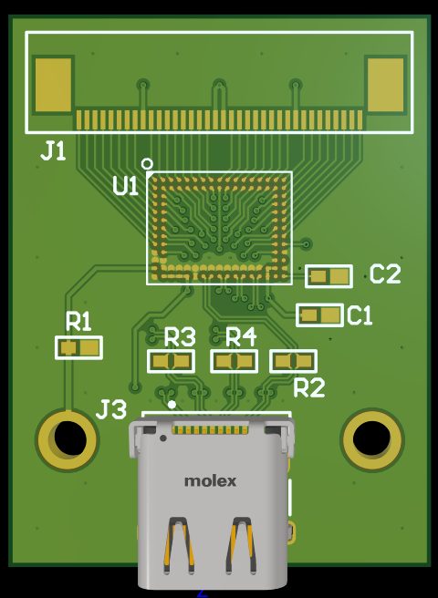
Design Issue (Before)

Slide 4
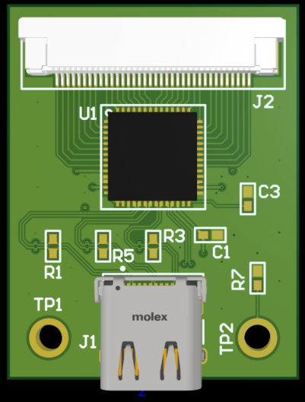
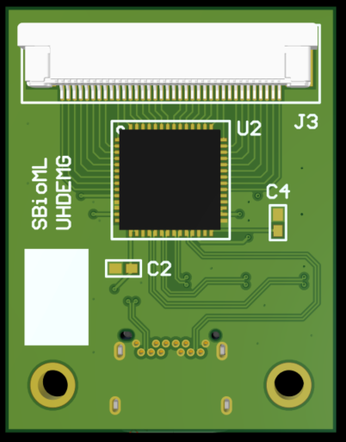
Design Issue (After)

Slide 5
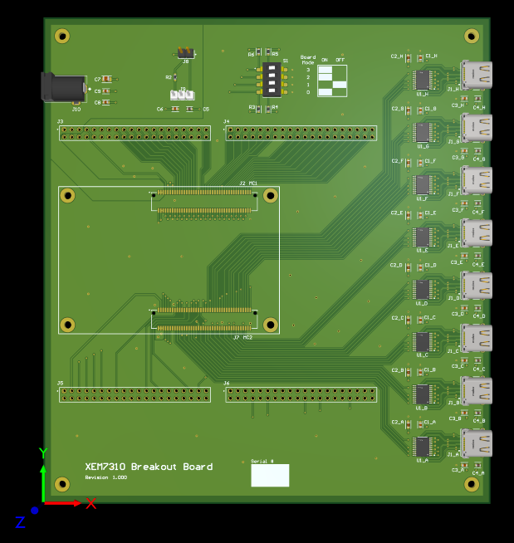
Design Issue (Before)

Slide 6
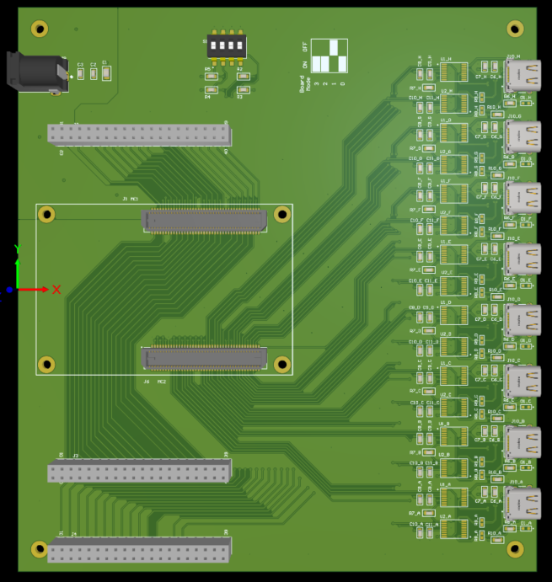
Design Issue (After)

Slide 7
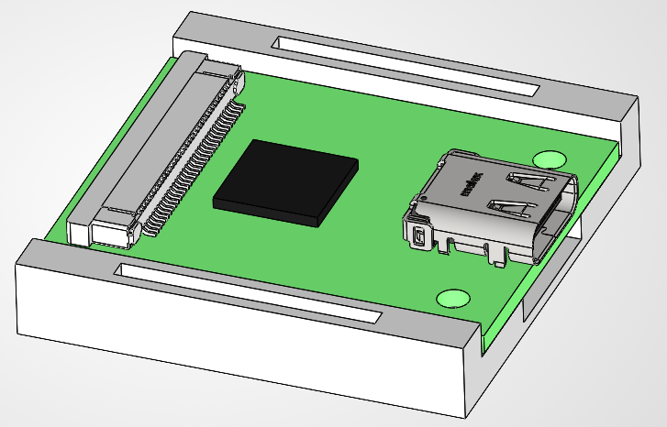
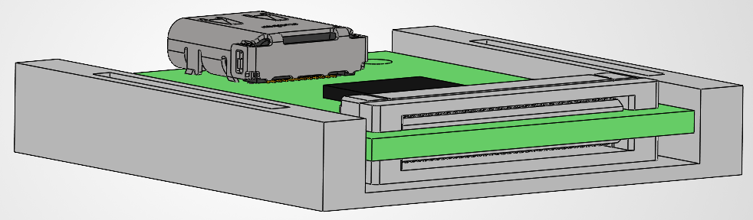
Mechanical Setup

Slide 8
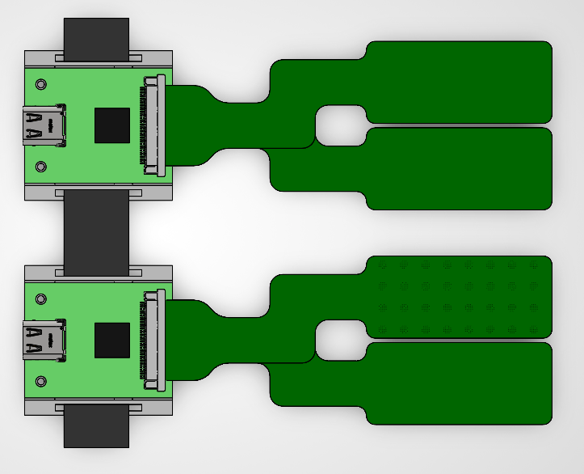
Hand
Elbow

Slide 9
Next steps
Scholarships applications
PCB Review / Correct the designs / Order
Test plans and protocol preparation
Prepare code for collecting data

